Slide 1
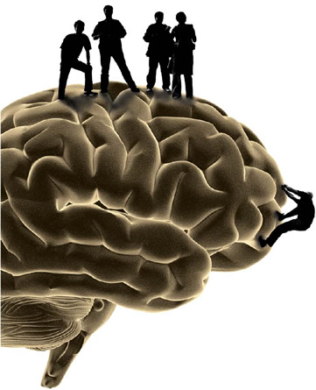

Israel and
Behavioural Economics
Adventures in Decision Making at the Asia Pacific Meeting of the Economic Science Association and the Centre for the Study of Rationality Workshop on Regret, Emotions, and Decision Making
March 23-29, 2009

Slide 2
Behavioural Economics
What are these people interested in?
  Decision making, Game theory, etc.
  Prisoner's Dilemma
  Ultimatum Game
  Binary Choice between Gambles
  Auctions, Markets, Common Goods, Trust, etc.
Common tools?
  Questionnaires, Lab experiments with real money
  Prospect Theory

Slide 3
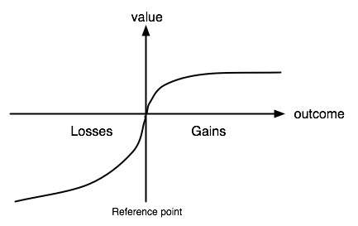
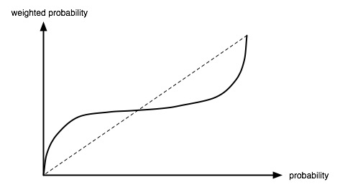
Prospect Theory
Kahneman & Tversky (Nobel Prize in Economics)
  Expected Utility Theory doesn't work
  Need to adjust values and probabilities
  v(x) requires a reference point
  and makes losses worth
  more than gains (loss aversion)
  w(p) handles overreacting to
  small probability events

Slide 4
Prospect Theory: Evidence
Loss Aversion
  Choose A: +200 or B: 67% 0; 33% +600 [A>B]
  Choose A: -400 or B: 67% -600; 33% 0 [A<B]
Overreact to small probabilities
  Buying lottery tickets
  Buying insurance
  Cumulative Prospect Theory changes w(p) to be w(p,x) where it overweights events that are both rare and extreme

Slide 5
Some General Notes
Emphasis on verbal descriptions of options
Descriptive models
  Measure behaviour, find curves that fit individuals
  Finding patterns (loss aversion), use for explanation
But
  No mechanism
  Post-hoc fitting, not prediction in new domains

Slide 6
Prospects in other domains
Does this apply to things other than money?
  Yes
  Life expectancy, weight, waiting times, pain
Does this apply to small versus large values?
  Yes
  Pennies vs thousands of dollars (hypothetically)

Slide 7
Relative Thinking
$125/$25 jacket/calculator question
  Will drive 20min to save $5 on $25, but not $5 on $125
New domain: boring questions
  Initial $5, then $0.15 per really really boring question
  Compare to initial $15
  Predictions
    Prospect theory: no diff
    Reciprocity: more for $15
    Relative: more for $5
  “found a slight tendency for relative, but not statistically significant”
(Note: Gigerenzer, 1998)

Slide 8
Emotions: Fear vs anger
How do emotions affect decisions?
  Most work on emotions in this area just looks at +ve vs -ve emotions
  Fear vs anger? (abstract -ve vs concrete -ve)
  Risk aversion: fear>happiness>anger
Does the type of gamble matter? Yes
  lotteries give fear>happiness>anger
  Interactions give fear<happiness<anger
  Note that for both cases -ve=+ve

Slide 9
Reconsidering Loss Aversion
Ido Erev
  “The assertion that losses loom larger than gains is one of the best known implications of prospect theory.”
    I'm not sure it's an implication – feels more like an assumption
  Initial data
    0 vs 50% -1000; 50% +1000
    +1000 vs 50% 0; 50% +2000: didn't become more attractive either as a hypothetical or as real money
  What's happening?

Slide 10
Reconsidering Loss Aversion
Framing effect:
  If describe gamble, ask “would you do it”, makes status quo more attractive
  If describe both options, pick one, gamble becomes more likely
Mental exhaustion effect:
  Loss aversion found in long experiments (>50 choices)
  Re-analyzed raw data, found no loss aversion at beginning (<10 choices)
  Loss aversion also goes away with feedback
    Comes back with large magnitudes

Slide 11
Prediction Competition
Why was I there?
  Ido Erev organized a competition to see whether choice models could predict
  3 Conditions
    Describe the gambles, then pick
    Explore the gambles for a while, then pick
    No description, just keep picking 100 times
  I won the last condition (most predictive model)

Slide 12
Repeated Binary Choice

Slide 13
Repeated Binary Choice
8

Slide 14
Repeated Binary Choice
Safe vs. Risky Options
  One button always gave a reward M
  Other gave reward H with probability p, otherwise L
120 Conditions
  Varying L, M, H, and p
  Values between -30 and +30, rare events (p< .1 or p>.9) in about 2/3 of the problems
Generalization
  Only given data from 60 Conditions (proportion of risky choices over 100 trials, 20 subjects)
  Need to predict results from other 60 conditions.

Slide 15
Competition Results
Description: won by prospect theory
Explore, then pick: won by combining models
  If have multiple models and no theoretical reason to choose one over the other, then average them all
  No weighting
  But there's no way that's what people are doing

Slide 16
Cognitive Modelling
Cognitive Science:
  How does the brain work?
  Both what it does and how it does it
  Identifying the underlying mental mechanisms
Why would this be useful?
  If understand components and how they fit together, should be able to make new models for new situations
  It should be possible to make a predictive model without running any experiments

Slide 17
Mechanistic Models
Constraints on cognitive models
  Process models (consistent flow of time)
  Components correspond to brain components
Benefit of constraints
  Claim: doing this leads to better predictions
  Predictions across many domains (reaction time, fMRI, lesions, interventions, learning trajectory, etc.)

Slide 18
Cognitive Architectures
Avoiding Reinventing the Wheel
  Cognitive models are highly complex
  A lot of parameters, possibilities
  Solution: use common components, parameter values
Benefit of constraints
  Acts somewhat like a Bayesian prior in new tasks
  Biases models towards components and algorithms that have previously shown to be successful
  Reasonable to believe that they will be useful here too

Slide 19
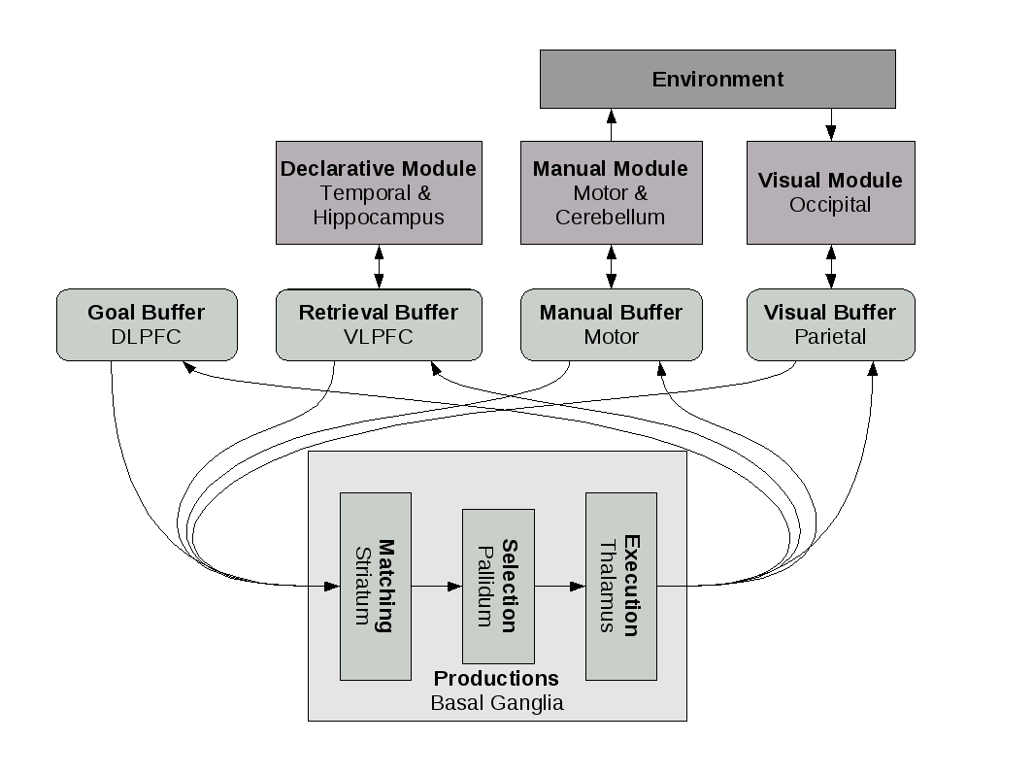
ACT-R
The most widely used cognitive architecture
  15-30 years old; about 100 active researchers
Used in many domains
  mathematical reasoning,
  serial recall, human
  computer interaction,
  semantic priming,
  n-back, sleep
  deprivation, driving
  while dialing, etc.,
  etc.

Slide 20
Cognitive Architectures
Why use ACT-R?
  Usually used in situations with multiple types of data
    Accuracy, reaction time, fMRI, task interference, experience
Validated Components
  We have reason to believe the brain can use these components in other tasks
  Reasonable to believe it could also use them in this task
  Acts somewhat like a Bayesian prior

Slide 21
The Model
Treat repeated choice as a memory task
  Recall what happened after pressing each button
  Pick the biggest
Constrain recall based on context
  If I just pressed AA, only consider previous experiences with AAA and AAB
  History of 2 from rock-paper-scissors, baseball

Slide 22
The Model
ACT-R Memory
  Odds of a memory being needed decay as a power law over time (Anderson & Schooler, 1991)
  Each memory has activation A
  Let ti be the times since this memory was seen
  Recalls the item with highest A, if above threshold T
  Magnitudes are not well distinguished
    Blend together, linearly weighted by A
  Only one recall at a time:

Slide 23
Model Parameters
Decay rate d
  Always 0.5
Size of context
  2 is consistently best
Noise s
  Usually between 0.2 and 0.5
Threshold T
  Almost always between -3 and 0
Two parameter model

Slide 24
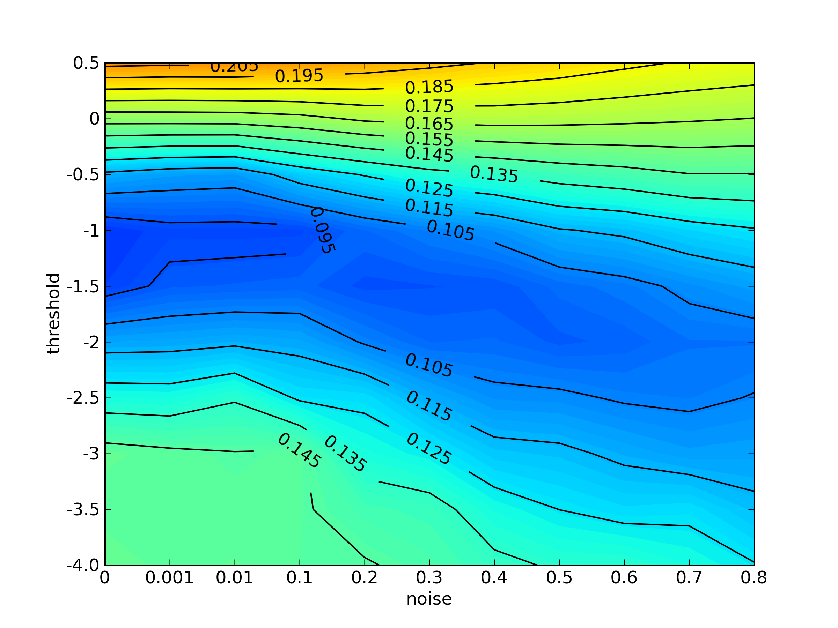
Evaluation
RMSE to human data on 60 conditions

Slide 25
Evaluation
Best performance is s=0, T=-1
  This is not a common value for s
  What is happening here?
Let's look at model and human performance across the 60 conditions

Slide 26
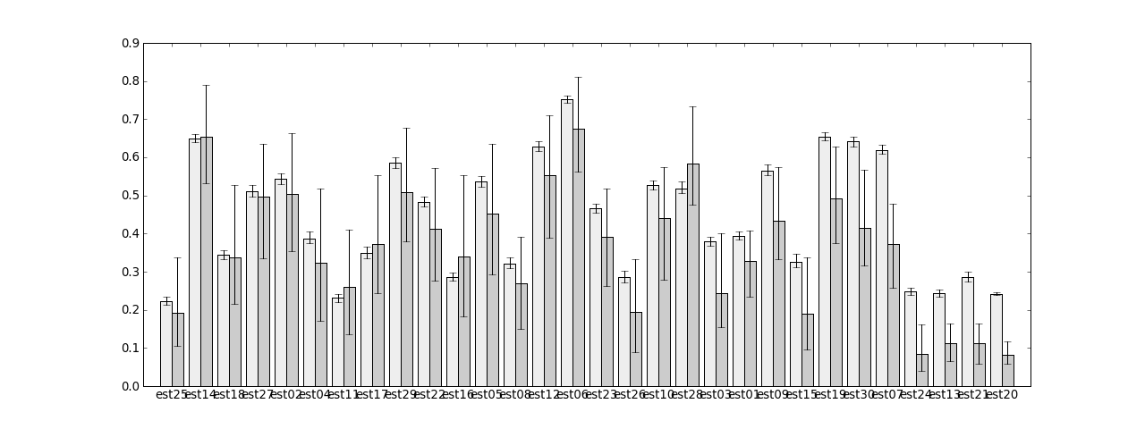
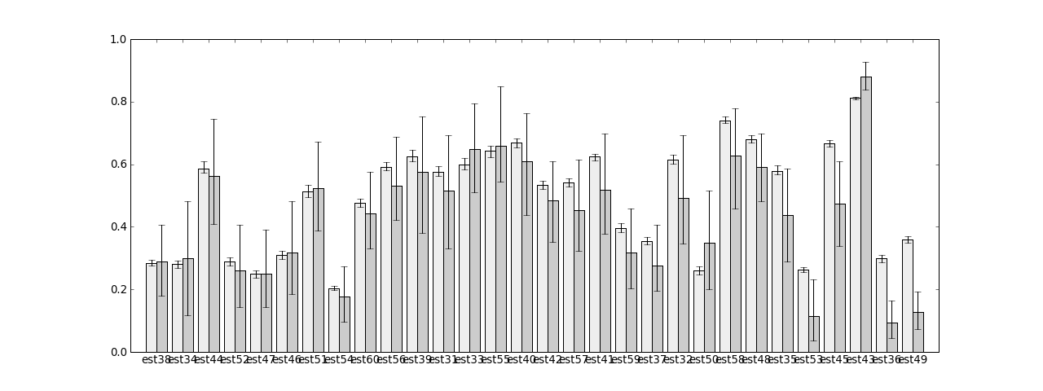

Slide 27
Evaluation
Some measures consistently don't match
  Can't get them to match while other ones do too
  On the other measures, there is no statistically significant difference between model and empirical data
Conclusion
  The model does not accurately capture a few conditions
  Something else may be happening here
  Should not try to average over those models
    Separate groups of conditions

Slide 28
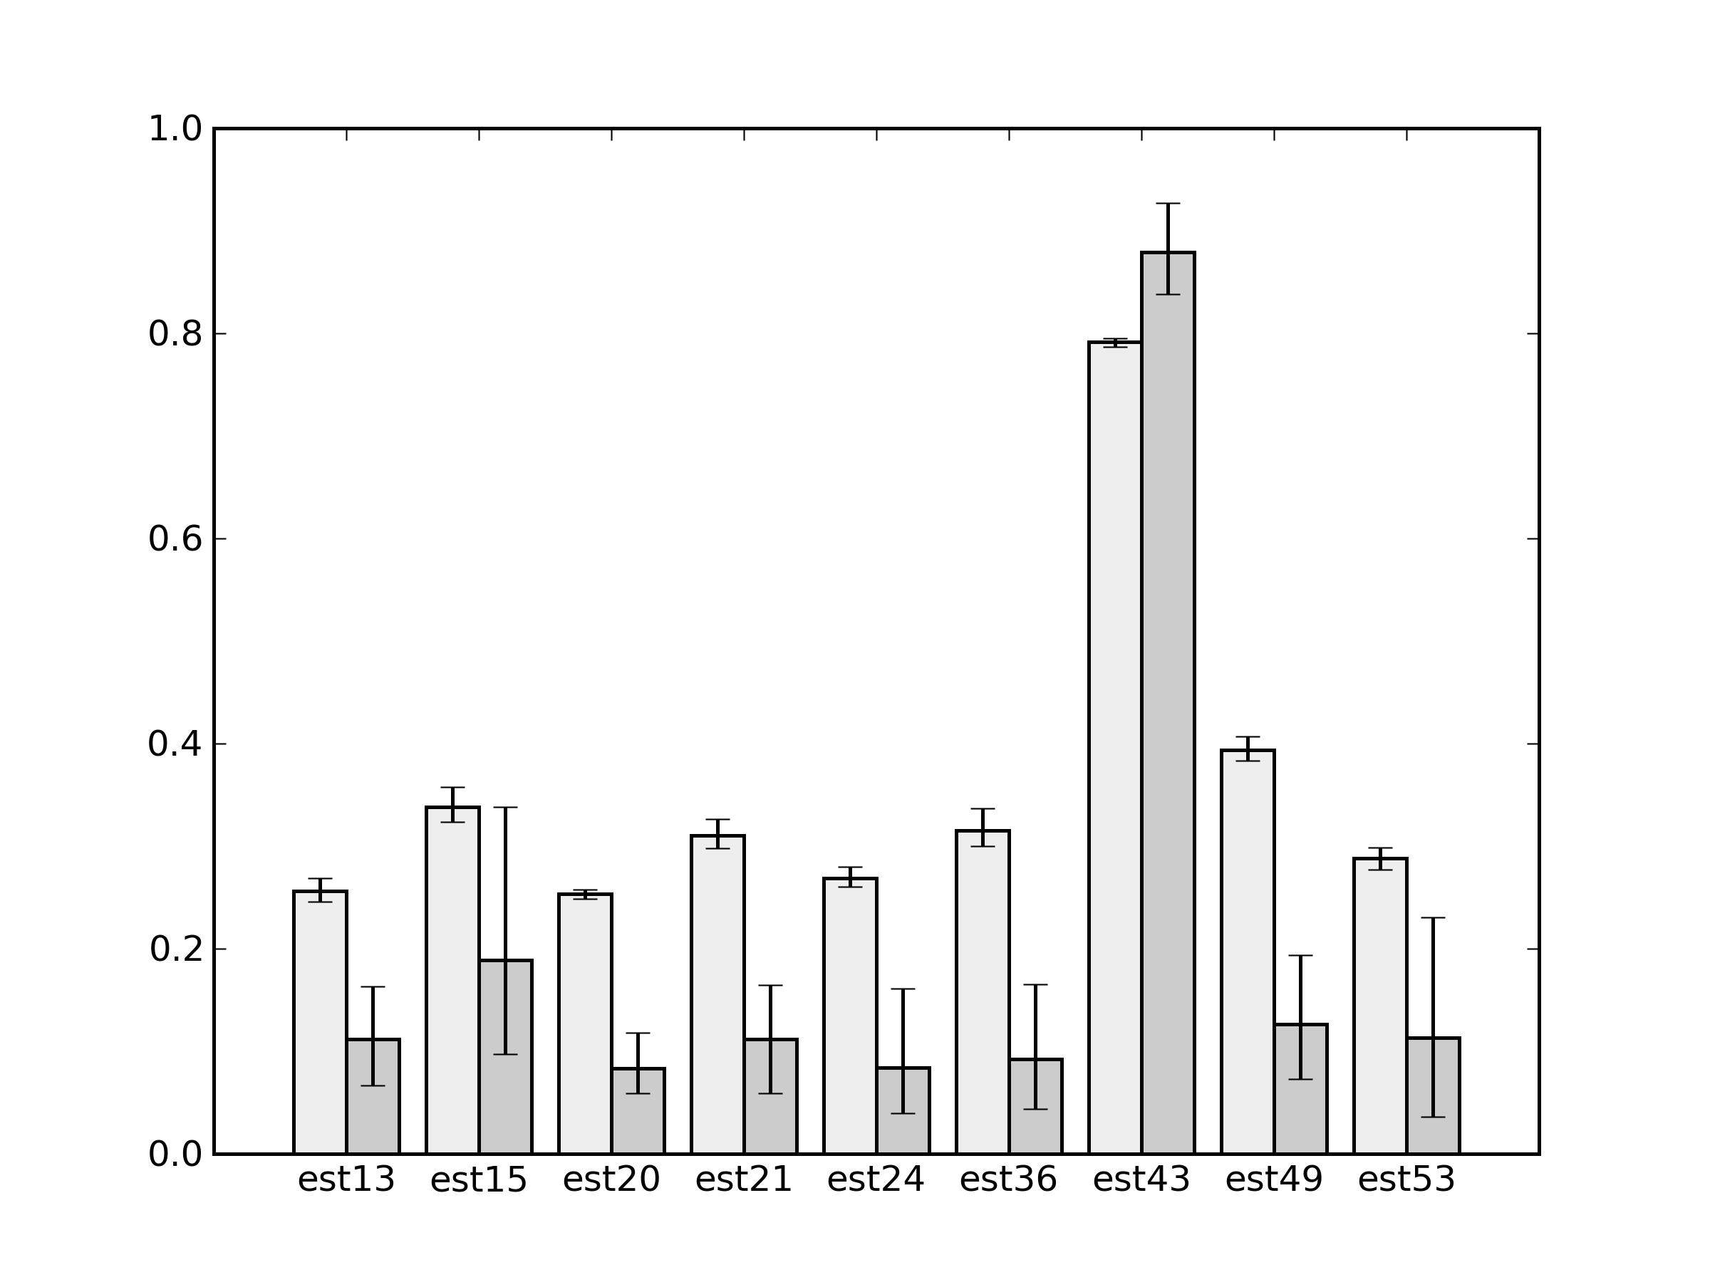
Extreme Conditions

Slide 29
Extreme Conditions
Conditions
  All of the situations where people exhibited extreme behaviour
  Perhaps there is a strategy shift when people notice one button is consistently better?
# H p L M
13 -2 0.05 -10.4 -9.4
15 -8.9 0.08 -26.3 -25.4
20 -4.3 0.6 -16.1 -4.5
21 2 0.1 -5.7 -4.6
24 9.2 0.05 -9.5 -7.5
36 5 0.08 -9.1 -7.9
43 22.9 0.06 9.6 9.2
49 13.4 0.5 3.8 9.9
53 25.7 0.1 8.1 11.5

Slide 30
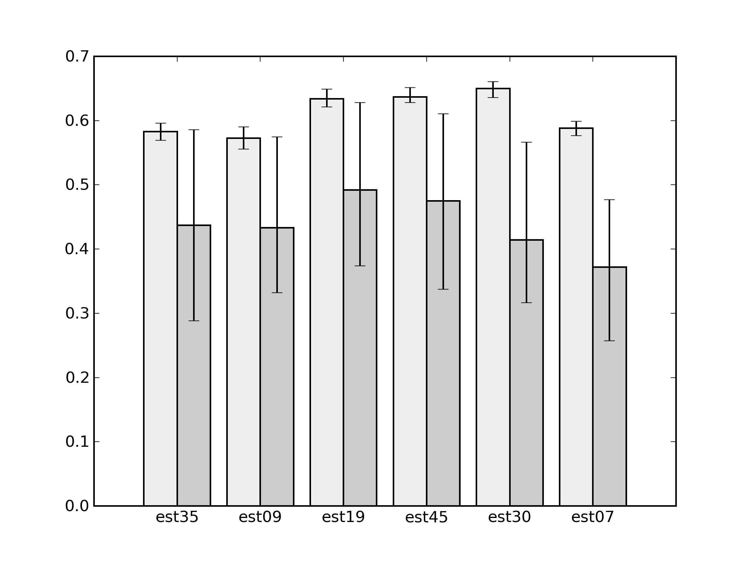
60/40 Error Conditions

Slide 31
60/40 Error Conditions
Not sure what is happening here
  Not even sure if it's a real effect
  95% confidence intervals will be wrong 5% of the time
  Something to do with rare negative outcomes
    Model likes risk in these conditions more than people do
# H p L M
35 3 0.93 -7.2 2.2
9 -5.7 0.95 -16.3 -6.1
19 -6.5 0.9 -17.5 -8.4
45 2.8 0.8 1 2.2
30 3 0.91 -7.7 1.4
7 -5.6 0.7 -20.2 -11.7

Slide 32
Conservative Modelling
The model is not perfect
  Instead of averaging over all the conditions, identify the conditions for which the model is good
What do we mean by a good match?
  Let's continue looking at confidence intervals
  After removing the consistently bad conditions, what is the next worst condition?
  Measure this for each parameter setting

Slide 33
Scaled Maximum Likely Difference
Likely Difference
  How bad could the model be, but still be consistent with the observed confidence intervals
Scaled Likely Difference
  Linearly scaled so that <1 means no statistically significant difference between model and data
Scaled Maximum Likely Difference
  Maximum of SLD values across all conditions
  Highly conservative worst-case assessment of model quality

Slide 34
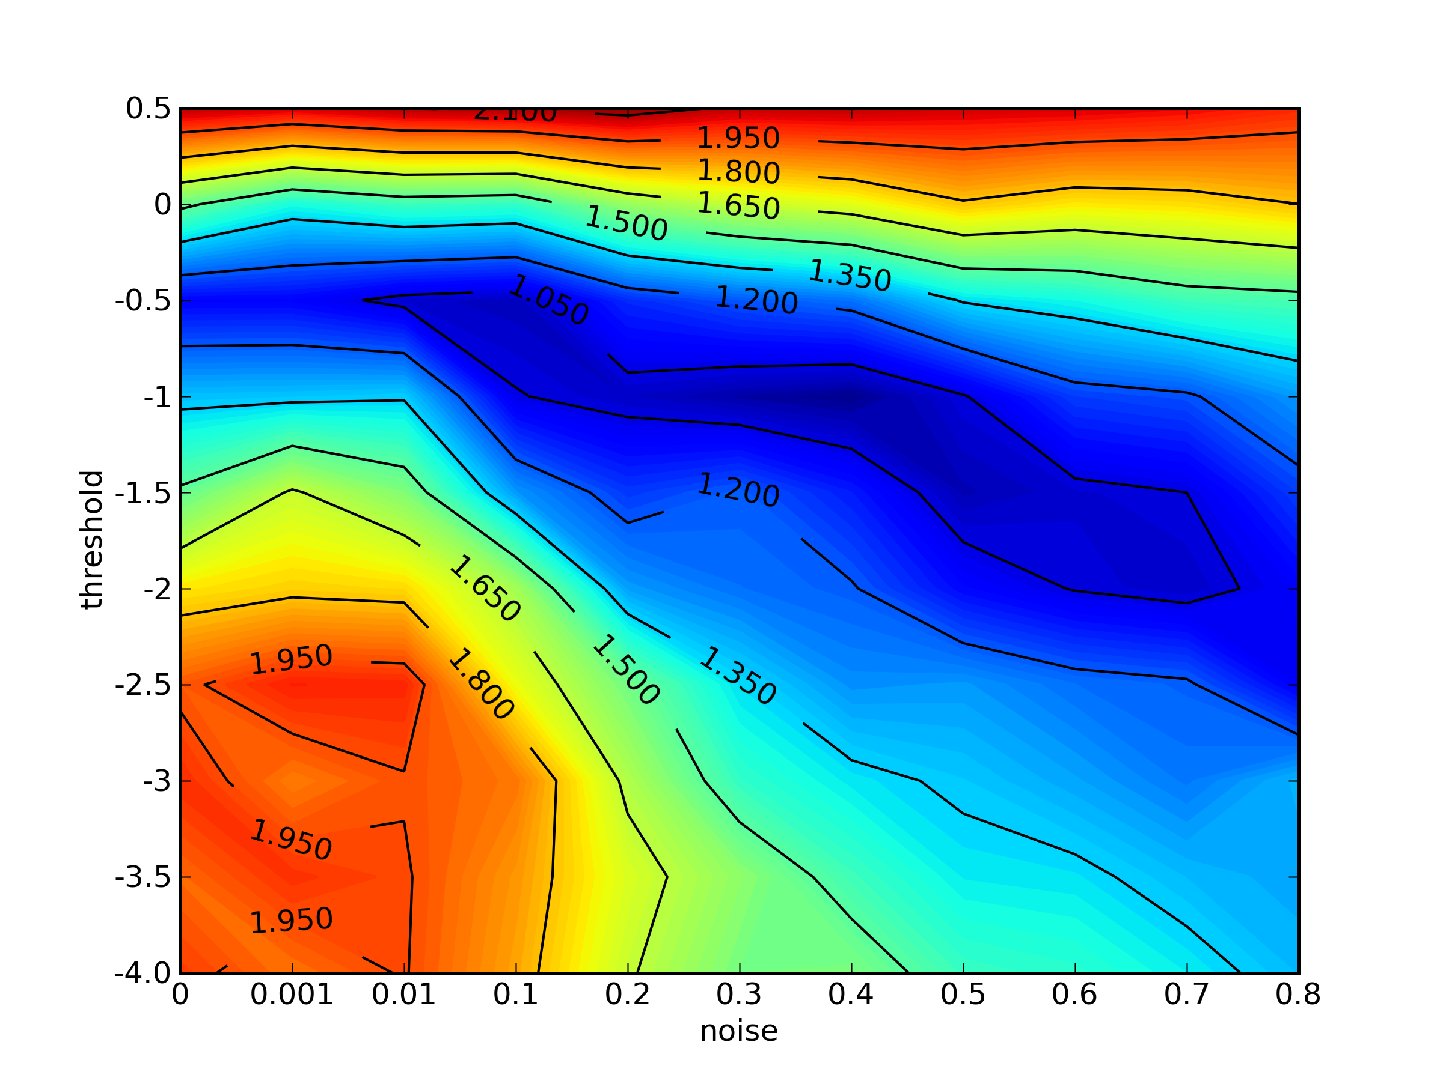
Scaled Maximum Likely Difference

Slide 35
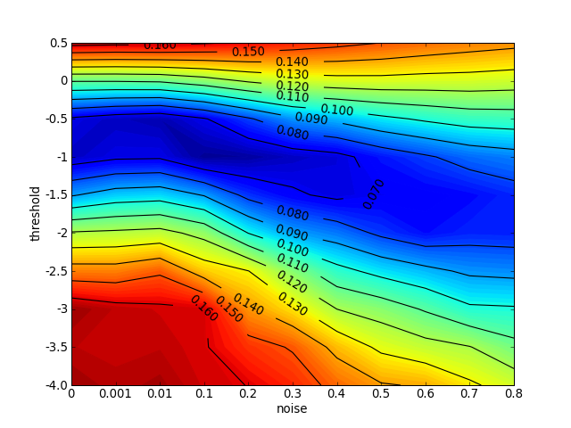
RMSE with conditions removed

Slide 36
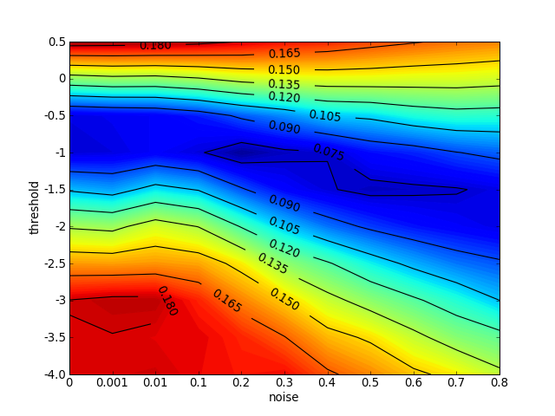
Testing Data

Slide 37
Conclusions
Useful to base a model on existing cognitive theory
  Constrains model parameters and functions to ones that have proven to be good in the past
  Acts as a Bayesian prior to give you more predictive accuracy than a small set of task-specific empirical data
Useful to identify conditions the model does not handle well
  No averaging over good and bad conditions
  Would not have won otherwise
  Helps direct future research

Slide 38
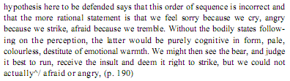
Heuristics and Metacognition
Asher Koriat
  William James (1884):
  Why the feeling? To help guide behaviour
    Emotions have a monitoring->control role
    e.g. Koriat & Goldsmith, 1996: confidence predicts likelihood of answering a question, even if confidence is uncorrelated to accuracy
Apply to memorizing a list of items
  Will choose to spend more time on the harder ones
    How do you know which ones are harder?
    By the amount of time spent on them

Slide 39
Heuristics and Metacognition
Very circular
  So let's play with their time perception
    Very visible clock with slight speed changes
    If clock runs slower, less confident in performance
Good heuristic
  Effort is data-driven, so time is a good diagnostic
  Metacognitive processes are parasitic on underlying cognitive ability
    Kids only start using the cue around grade 3

Slide 40
Heuristics and Metacognition
But there's a cycle
  control->monitor->control->monitor->...
  When studying, you can choose to allocate more time to some items
  Have some items worth 1pt, others worth 3pts
    Across: +ve correlation (judgment vs accuracy)
    Within: -ve correlation (unless there's lots of time pressure, which starts making it goal-driven within the 3pt items)

Slide 41
Regret: Generating Counterfactuals
Marcel Zeelenberg
  Given a scenario where something went badly:
    Generate 0/2/8 counterfactuals how it could be better
  Ask how much regret you would feel
    0=2>8
  If told that 2 is easy and 8 is hard
    0=2=8
  Experienced ease of generating counterfactuals is used to estimate regret
  But it won't be used if told it's not a good indicator

Slide 42
Regret: Fictive learning
Giorgio Coricelli
  Orbitofrontal cortex: representation of relative reward
  Can adjust by having feedback of what you would have gotten with the other choice
  Also look at patients with lesions to this area

Slide 43
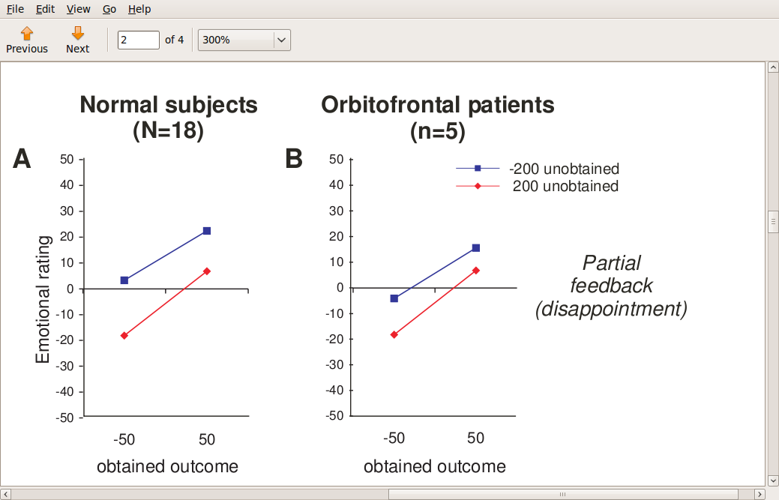
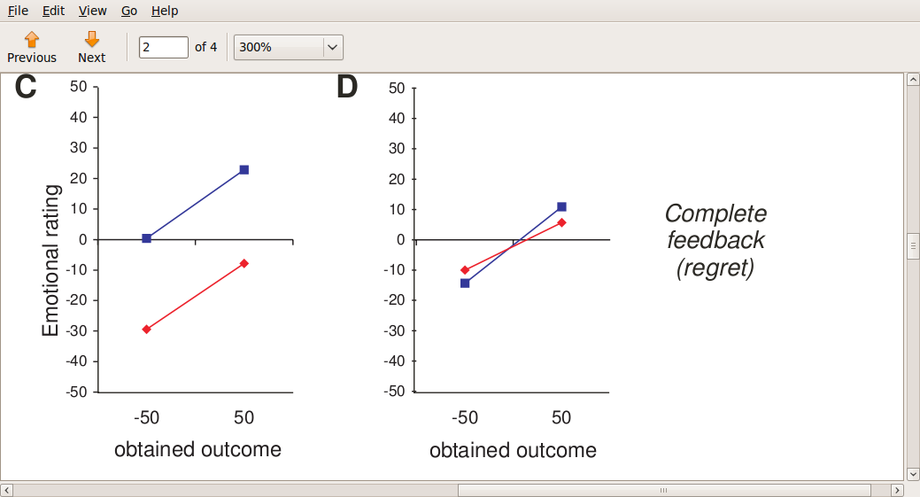
Regret: Fictive learning

Slide 44
Regret: Fictive Learning
Orbitofrontal patients can't do the counterfactual
  So the don't feel regret, and so don't use it to adjust behaviour
Two learning mechanisms
  Expected reward-based (prediction error)
    Obtained-expected (expected=Ap+B(1-p))
  Fictive learning
    Obtained-unchosen (A-B ignoring probability)
  Regression analysis of decisions
    Normals use expected and regret
    Orbitofrontals just use expected

