Slide 1
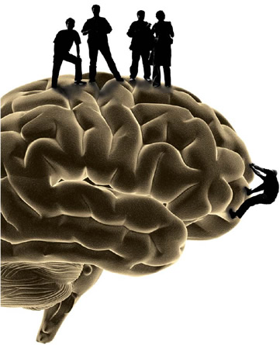
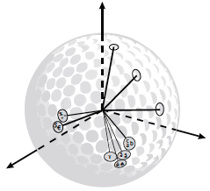
A Neurally Plausible Encoding of Word Order Information into a Semantic Vector Space
Peter Blouw, Chris Eliasmith {pblouw, celiasmith}@uwaterloo.ca
Centre for Theoretical Neuroscience, University of Waterloo <http://ctn.uwaterloo.ca>
Introduction
Our aim: to develop detailed neural models of lexical processing.
Present task: extending a recent approach to building neural simulations of cognitive processes (Eliasmith, 2013) to account for distributional models of semantics. Main focus is on word order encoding.
Simulation 1:
Nearest Neighbors
Simulation 2:
Position Retrieval
 | Context Space |  |  | Order Space
Eat
 |  | food get animals | 0.69 0.65 0.63 | get buy make | 0.89 0.87 0.86
Reading
 |  | read book writing | 0.66 0.61 0.61 | writing making business | 0.72 0.67 0.64
Went
 |  | came little got | 0.82 0.80 0.77 | turned ran came | 0.87 0.85 0.85
 |  | Word Before |  | Word After
King
 | rex luther rumbles |  | 0.38 0.22 0.17 | midas tut aietes | 0.42 0.42 0.39
President
 | vice activist egypts |  | 0.32 0.20 0.19 | eisenhower lincoln coolidge | 0.45 0.31 0.27
Sea
 | caspian aegean mediter-ranean |  | 0.22 0.22 0.19 | anenome level gull | 0.37 0.27 0.26
Past Approaches
Convolution with n-grams (Jones & Mewhort, 2007) and random permutation with binary vectors (Sahlgren, Holst, & Kanerva, 2008) to encode word order.
Our Approach – Convolution with Position Vectors
Example of n-gram encoding for words around ‘dog’:
S = “the dog chased a cat”
bigrams
trigrams
S Encoding
quadgrams
tetragram
All reported values are vector cosines. Target word in brackets for phrase completion tasks
Simulation 3: Phrase Completion
Random vocab vector for word i
Phrase |  | Activations
the [brainstem] |  | same (0.68) ground (0.66) british (0.66)
the [brainstem] is |  | sun (0.53) clapper (0.53) next (0.52)
the [brainstem] is much larger and more complex than the spinal cord |  | brainstem (0.33) sky (0.3) presidency (0.29)
emperor [penguins] |  | yuan (0.26) penguins (0.26) caligula (0.20)
[penguins] have |  | planaria (0.34) threepio (0.27) astronomers (0.26)
the emperor [penguins] have come to their breeding grounds |  | penguins (0.34) yuan (0.31) annelida (27)
I have to [run] now |  | operate (0.37) establish (0.35) levy (0.33)
I [have] to run now |  | wish (0.36) intend (0.35) wanted (0.35)
Thomas [Jefferson] wrote the declaration of independence |  | jefferson (0.38) aquinas (0.38) malthus (0.26)
Thomas [Edison] made the first phonograph |  | edison (0.26) toricelli (0.23) scot (0.23)
Thomas [Malthus] wrote that the human population increased |  | malthus (0.27) jefferson (0.22) sheer (0.20)
Placeholder vector for target word
Circular convolution operation
S Encoding
Vector for position j next to target
Much simpler than prior encodings, allows for same comparison of word vectors via their geometric proximity in a vector space (see figure for illustration)
Phrase completion and position retrieval also possible by measuring similarity between ‘probe’ encodings and word vectors
Simulations indicate performance is comparable to past approaches – all simulation materials drawn from Jones & Mewhort (2007)
Why the Encoding is Neurally Plausible
512 dimensional real-valued vectors, computations can implemented using simulated neurons (Eliasmith, 2013)
Binary, extremely high dimensional vectors cannot be easily implemented using neurons. N-gram encoding is very computationally expensive.
Same encoding used in detailed neural model of working memory (Choo & Eliasmith, 2010) and SPAUN, the world’s largest functional model of the brain (Eliasmith et al., 2012)
Next Steps
Incorporate more syntactic structure, extend beyond single-word representations
References
Choo, F.X., & Eliasmith, C. (2010). A spiking neuron model of serial order recall. Proceedings of the 32nd Annual Conference of the Cognitive Science Society.
Eliasmith, C. (2013). How to build a brain: A neural architecture for biological cognition. New York, NY: Oxford University Press.
Eliasmith, C., Stewart, T., Choo, F.X., Bekolay, T., DeWolf, T., Tang, Y., & Rasmussen, D. (2012). A large-scale model of the functioning brain. Science, 338.6111, 1202-1205.
Jones, M.N. & Mewhort, D. (2007). Representing word meaning and order information in a composite holographic lexicon. Psychological Review, 114.1, 1-37
Sahlgren, M., Holst, A., & Kanerva, P. (2008). Permutations as a means to encode order in word space. Proceedings of the 30th Annual Conference of the Cognitive Science Society

